Slide 1

SWD 392 - Software Architecture and Design

Slide 2
SWD392 Finite State Machines
Here is whre your presentation begin

Slide 3
Introduction
Describes finite state machine modeling concepts. In particular, a
state-dependent control class needs to be modeled with a finite state machine and depicted as a state chart.
Covers events, states, conditions, actions, entry and exit actions, composite states, and sequential and orthogonal states

Slide 4
Finite state machines are used for modeling the control and sequencing view of a system or object.
Notations used to define finite state machines are the state transition diagram, statechart, and state transition table.
In the UML notation, a state transition diagram is referred to as a state machine diagram.
The UML state machine diagram notation is based on Harel’s statechart notation (Harel 1988; Harel and Politi 1998).
This chapter starts by considering the characteristics of flat statecharts and then describes hierarchical statecharts.

Slide 5
Table of contents
01
FINITE STATE MACHINES AND STATE TRANSITIONS
02
EXAMPLES OF STATECHARTS
03
EVENTS AND GUARD CONDITIONS
04
ACTIONS
05
HIERARCHICAL STATECHARTS
06
GUIDELINES FOR DEVELOPING STATECHARTS
07
DEVELOPING STATECHARTS FROM USE CASES
08
EXAMPLE OF DEVELOPING A STATECHART FROM A USE CASE

Slide 6
01
FINITE STATE MACHINES AND STATE TRANSITIONS

Slide 7
10.1 FINITE STATE MACHINES AND STATE TRANSITIONS
A finite state machine (also referred to as state machine) is a conceptual machine with a finite number of states.
A state transition is a change in state that is caused by an input event.
Alternatively, the event might have no effect, in which case the finite state machine remains in the same state. The next state depends on the current state, as well as on the input event.
In an object-oriented model, the state-dependent view of a system is defined by means of one or more finite state machines, in which each finite state machine is encapsulated inside its own object.

Slide 8
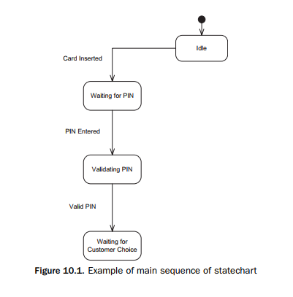
10.1.1 Events
An event is an occurrence at a point in time; it is also known as a discrete event, discrete signal, or stimulus.
The precedence of the two events is reflected in the state that connects them, as shown in Figure 10.1

Slide 9
10.1.2 States
A state represents a recognizable situation that exists over an interval of time.
Alternatively, an event can have a null effect, in which case the finite state machine remains in the same state.
In theory, a state transition is meant to take zero time to occur. In practice, the time for a state transition to occur is negligible compared to the time spent in the state

Slide 10
02
EXAMPLES OF STATECHARTS

Slide 11
10.2 EXAMPLES OF STATECHARTS
The use of flat statecharts is illustrated by means of two examples, an ATM statechart and a Microwave Oven statechart
10.2.1 Example of ATM Statechart
Consider an example, shown in Figure 10.1, of a partial statechart for an automated teller machine.
The initial state of the ATM statechart is Idle.
It is possible to have more than one transition out of a state, with each transition caused by a different event.
Figure 10.2 shows three possible state transitions out of the Validating PIN state. If the two PIN numbers match, the ATM makes the Valid PIN

Slide 12
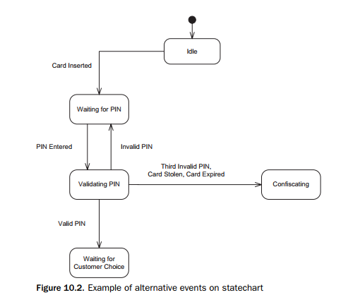

Slide 13
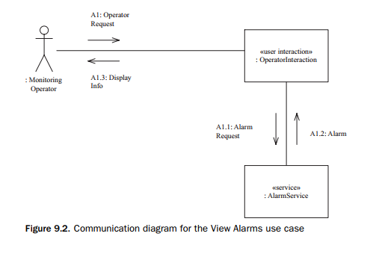
In some cases, it is also possible for the same event to occur in different states and have the same effect; an example is given in Figure 10.3.

Slide 14
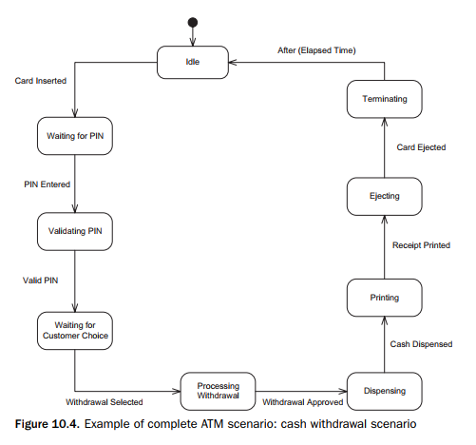
Next consider the case in which, after successful PIN validation, the customer decides to withdraw cash from the ATM, as shown in Figure 10.4.

Slide 15
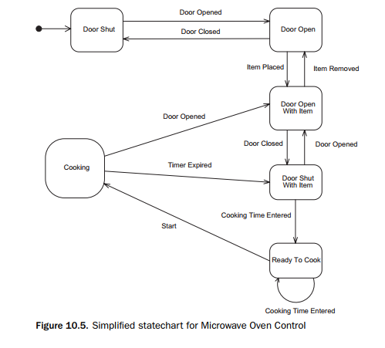
10.2.2 Example of Microwave Oven Statechart
As a second example of a statechart, consider a simplified version of the Microwave Oven Control statechart, which is shown in Figure 10.5.
The statechart shows the different states for cooking food.

Slide 16
03
EVENTS AND GUARD CONDITIONS

Slide 17
10.3 EVENTS AND GUARD CONDITIONS
It is possible to make a state transition conditional through the use of a guard condition.
The notation used is Event [Condition].
A condition is a Boolean expression with a value of True or False, which holds for some time.
The fact that an event has occurred can be stored as a condition that can be checked later.
Examples of guard conditions in Figure 10.6.
-Zero Time and Time Remaining in the microwave statechart. The two transitions out of the Door Open with Item state are Door Closed [Zero Time] and Door Closed [Time Remaining].

Slide 18
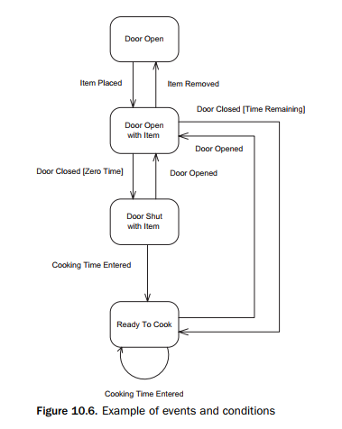

Slide 19
04
ACTIONS

Slide 20
10.4 ACTIONS
Associated with a state transition is an optional output action.
An action is a computation that executes as a result of a state transition.
The action executes instantaneously at the state transition; thus conceptually an action is of zero duration.
In practice, the duration of an action is very small compared to the duration of a state.

Slide 21
10.4.1 Actions on State Transitions
A transition action is an action that is a result of a transition from one state to another – it could also happen if the state transitions to itself.
As an example of actions, consider the ATM statechart.
- This example is shown in Figure 10.7, which shows the partial statechart for the ATM (originally shown in Figure 10.1) with the actions added.

Slide 22
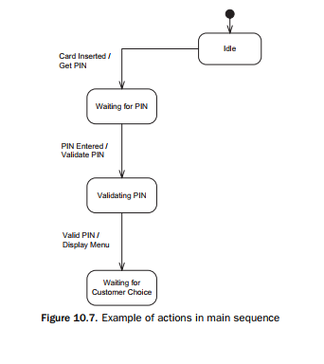

Slide 23
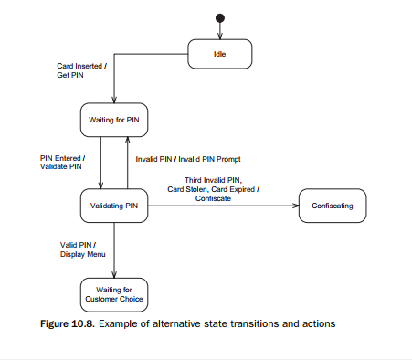
An example of a statechart with alternative actions is shown in Figure 10.8.

Slide 24
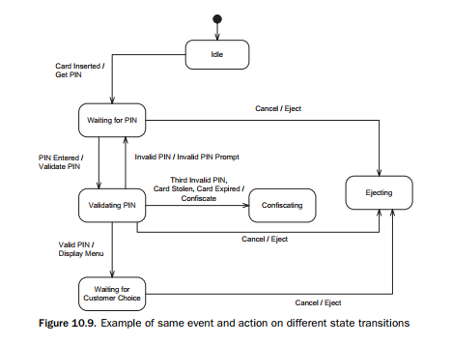
Another situation is that the same event can cause transitions out of several states, with the same action in each case.
An example of this is given in Figure 10.9.

Slide 25
10.4.2 Entry Actions
An entry action is an instantaneous action that is performed on transition into the state.
Whereas transition actions (actions explicitly depicted on state transitions) can always be used, entry actions should only be used in certain situations.
The best time to use an entry action is when the following occur:
- There is more than one transition into a state.
- The same action needs to be performed on every transition into this state.
- The action is performed on entry into this state and not on exit from the previous state.

Slide 26
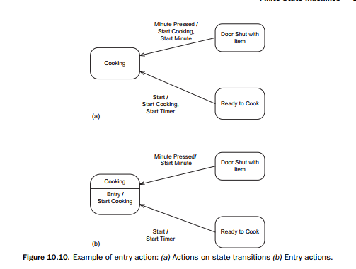
An example of an entry action is given in Figure 10.10.

Slide 27
10.4.3 Exit Actions
An exit action is an instantaneous action that is performed on transition out of the state.
The best time to use an exit action is when the following occur:
- There is more than one transition out of a state.
- The same action needs to be performed on every transition out of the state.
- The action is performed on exit from this state and not on entry into the next state.

Slide 28
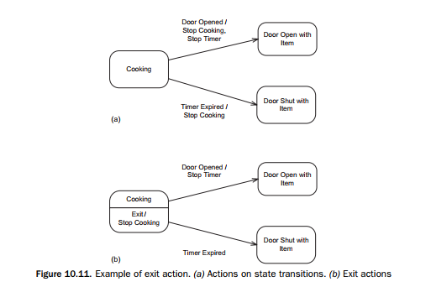
An example of an exit action is given in Figure 10.11.

Slide 29
05
HIERARCHICAL STATECHARTS

Slide 30
10.5 HIERARCHICAL STATECHARTS
One of the potential problems of flat statecharts is the proliferation of states and transitions, which makes the statechart very cluttered and difficult to read.
A very important way of simplifying statecharts and increasing their modeling power is to introduce composite states, which are also known as superstates, and the hierarchical decomposition of statecharts.
The objective of hierarchical statecharts is to exploit the basic concepts and visual advantages of state transition diagrams, while overcoming the disadvantages of overly complex and cluttered diagrams, through hierarchical structuring.

Slide 31
10.5.1 Hierarchical State Decomposition
Statecharts can often be significantly simplified by the hierarchical decomposition of states.
Composite state is decomposed into two or more interconnected sequential substates.
This kind of decomposition is referred to as sequential state decomposition.
An example of hierarchical state decomposition is given in Figure 10.12a

Slide 32
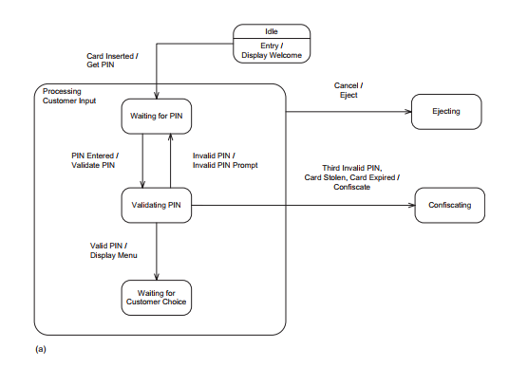

Slide 33
10.5.2 Composite States
Composite states can be depicted in two ways on statecharts, as described next.
A composite state can be depicted with its internal substates, as shown for the Processing Customer Input composite state in Figure 10.12a.
Alternatively, a composite state can be depicted as a black box without revealing its internal substates, as shown in Figure 10.12b
Each transition into the composite state Processing Customer Input is, in fact, a transition into one (and only one) of the substates on the lower-level statechart.

Slide 34
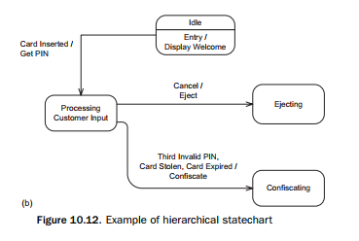

Slide 35
10.5.3 Aggregation of State Transitions
The hierarchical statechart notation also allows a transition out of every one of the substates on a statechart to be aggregated into a transition out of the composite state
Careful use of this feature can significantly reduce the number of state transitions on a statechart.
Consider the Figure 10.9, in which aggregation of state transitions would be useful.
Customer to press the Cancel button on the ATM machine in any of the three states Waiting for PIN, Validating PIN, and Waiting for Customer Choice.

Slide 36
10.5.4 Orthogonal Statecharts
Another kind of hierarchical state decomposition is orthogonal state decomposition, which is used to model different views of the same object’s state.
With this approach, a high-level state on one statechart is decomposed into two (or more) orthogonal statecharts.
. Although orthogonal statecharts can be used to depict concurrent activity within the object containing the statechart, it is better to use this kind of decomposition to show different parts of the same object that are not concurrent.

Slide 37
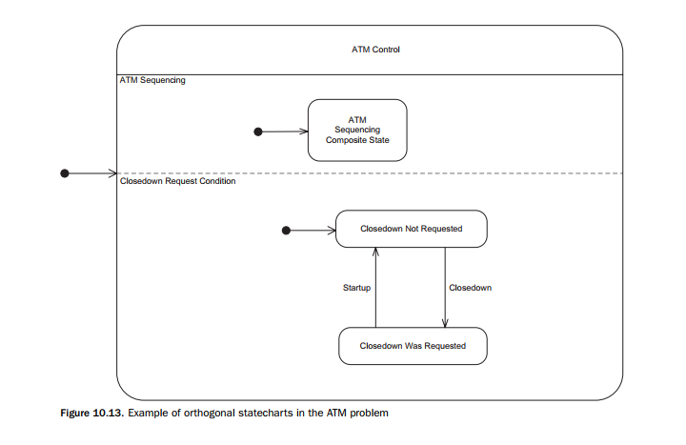
The use of orthogonal statecharts to depict conditions can be seen in the ATM example.
This case is illustrated in Figure 10.13

Slide 38
9.1.2 Sequence Diagrams
The interaction among objects can also be shown on a sequence diagram.
A sequence diagram shows the objects participating in the interaction and the sequence in which messages are sent.
Sequence diagrams can also depict loops and iterations.
Sequence diagrams and communication diagrams depict similar (although not necessarily identical) information, but in different ways.
In the following example, however, the messages on the sequence diagram are numbered to show their correspondence to the communication diagram.
An example of a sequence diagram for the View Alarms use case is shown in Figure 9.3. This sequence diagram conveys the same information as the communication diagram shown in Figure 9.2.

Slide 39
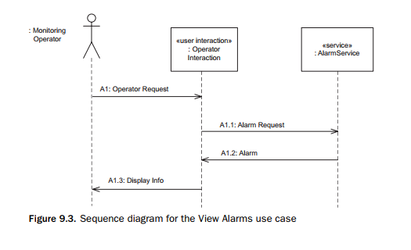

Slide 40
06
GUIDELINES FOR DEVELOPING STATECHARTS

Slide 41
10.6 GUIDELINES FOR DEVELOPING STATECHARTS
The following guidelines apply to developing either flat or hierarchical statecharts, unless otherwise explicitly stated:
- A state name must reflect an identifiable situation or an interval of time when something is happening in the system.
- On a given statechart, each state must have a unique name.
- It must be possible to exit from every state.
- On a sequential statechart, the statechart is in only one state at a time.
- Do not confuse events and actions.
- An event happens at a moment in time.
- An action is a command – for example, Dispense Cash, Start Cooking, Eject.
- An action executes instantaneously.
- A condition is a Boolean value.
- Actions and conditions are optional.

Slide 42
07
DEVELOPING STATECHARTS FROM USE CASES

Slide 43
10.7 DEVELOPING STATECHARTS FROM USE CASES
To develop a statechart from a use case, start with a typical scenario given by the use case – that is, one particular path through the use case.
Usually, an input event from the external environment causes a transition to a new state, which is given a name corresponding to what happens in that state.
Initially, a flat statechart is developed that follows the event sequence given in the main scenario.
In fact, the states represent consequences of actions taken by the actor, either directly or indirectly.
The actions resulting from each alternative state transition also need to be considered.
The partial statecharts will need to be integrated to form a complete statechart.
To integrate two partial statecharts, it is neces- sary to find one or more common states.
A common state might be the last state of one statechart and the first state of the next statechart.
The integration approach is to integrate the partial statecharts at the common state, in effect superimposing the common state of the second statechart on top of the same state on the first statechart.
There are actually two main approaches to developing hierarchical statecharts.
- top-down approach
- first develop

Slide 44
08
EXAMPLE OF DEVELOPING A STATECHART FROM A USE CASE

Slide 45
10.8 EXAMPLE OF DEVELOPING A STATECHART FROM A USE CASE
Consider the ATM Control statechart from the Banking System case study.
10.8.1 Develop Statechart for Each Use Case
In this example, we will consider the use cases for Validate PIN and Withdraw Cash.
For each use case, a statechart is constructed as illustrated in Figures 10.14 and 10.15.

Slide 46
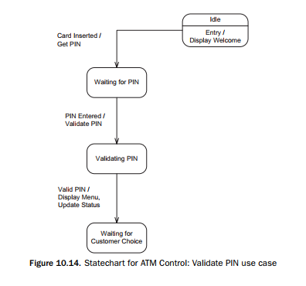
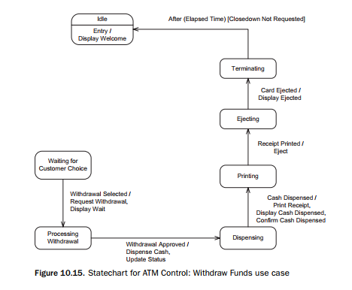

Slide 47
10.8.2 Consider Alternative Sequences
After the first version of the statechart is completed, further refinements can be made
To complete the statechart, it is necessary to consider the effect of each alternative sequence described in the Alternatives section of the use cases.
Figure 10.16 shows the Withdraw Funds statechart with the alternative sequences added to the main sequence.

Slide 48
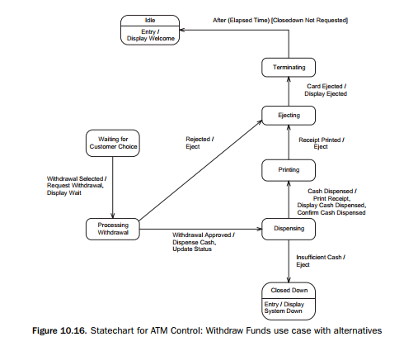

Slide 49
10.8.3 Develop Integrated Statechart
The integrated statechart consists of the integration of the use case–based statecharts, after consideration of alternatives.
This statechart would represent the main sequence through each use case together with the alternatives.
Figure 10.17 shows the integrated statechart from the Validate PIN and Withdraw Cash statecharts, with main and alternatives sequences.

Slide 50
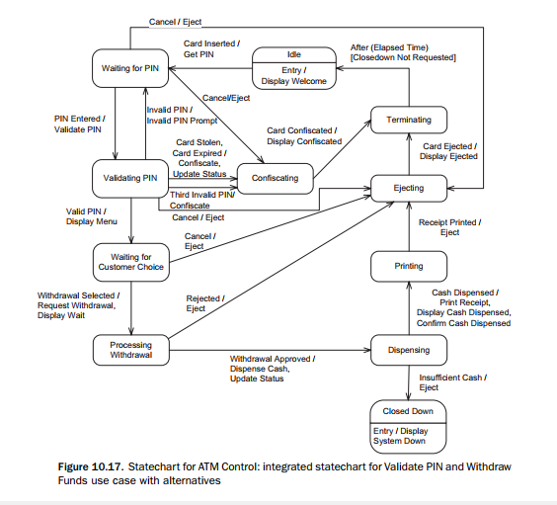

Slide 51
10.8.4 Develop Hierarchical Statechart
It is usually easier to initially develop a flat statechart.
After enhancing the flat statechart by considering alternative events.
- Look for ways to simplify the statechart by developing a hierarchical statechart.
- In particular, look for situations in which the aggregation of state transitions simplifies the statechart.
The hierarchical statechart for ATM Control is shown in Figures 10.18 through 10.21.

Slide 52
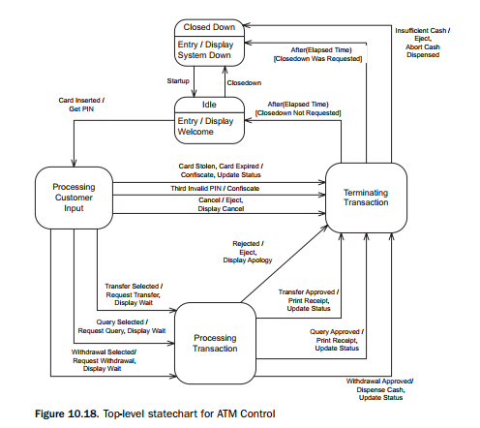
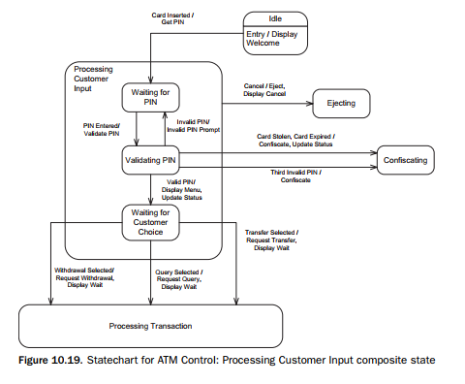

Slide 53
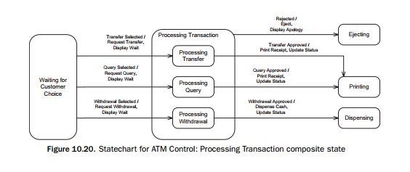

Slide 54
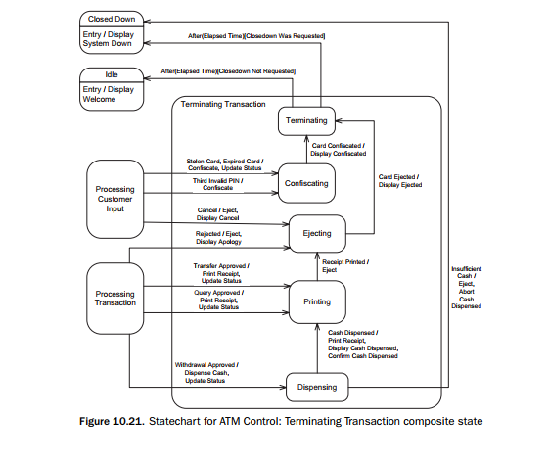

Slide 55
Thanks!

